Slide 1
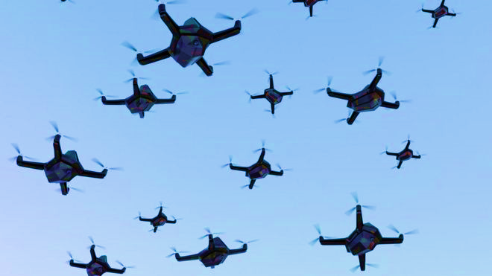
PAST APPLICATIONS OF DRONES

Slide 2
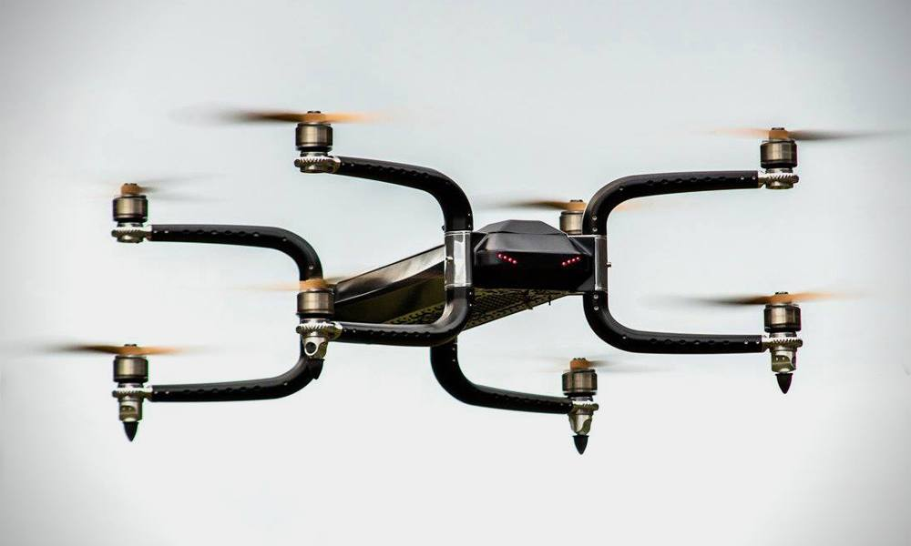
GRIFF Aviation 300
Payload Capacity: Up to 300 kg (660 lbs)
Flight Time: Approximately 30-60 minutes, depending on payload and conditions
Range: Up to 100 km (62 miles) depending on configuration
Max Speed: Around 70 km/h (43 mph)
Dimensions: Varies based on configuration, typically around 2.5 m (8.2 ft) in diameter
Power Source: Hybrid or electric options available
Control System: Autonomous and manual flight modes
Camera Options: Can be equipped with various payloads including cameras and sensors
Applications: Logistics, emergency response, surveillance, and more
Type: Brushless DC motors
Number of Motors: Usually configured with multiple motors (often eight) for enhanced stability and redundancy

Slide 3
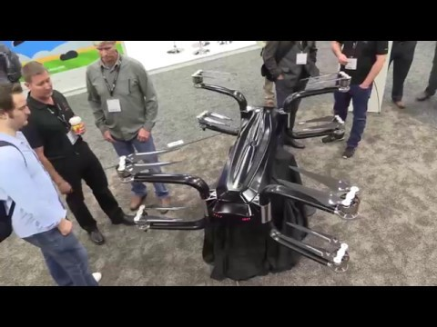

Slide 4
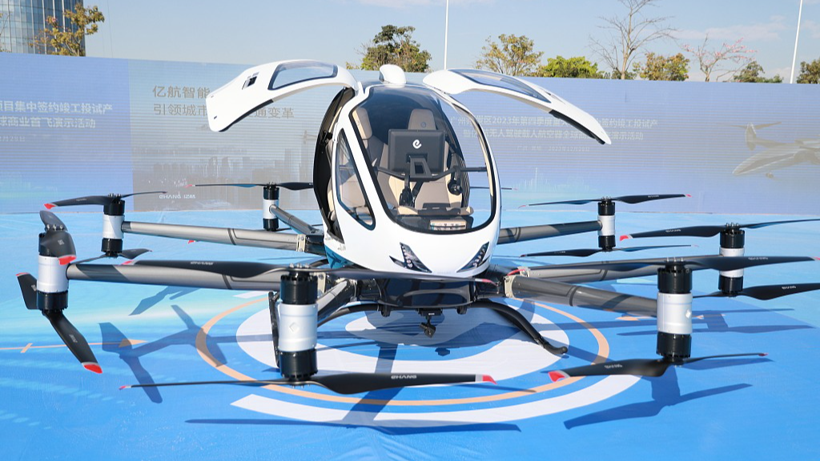
Ehang EH216-S
Capacity: Designed for 2 passengers (or equivalent cargo)
Payload Capacity: Up to 220 kg (485 lbs)
Flight Time: Approximately 30 minutes, depending on conditions and payload
Cruising Speed: Around 100 km/h (62 mph)
Range: Up to 35 km (22 miles) on a single charge
Dimensions: Approximately 4.2 m (13.8 ft) in length and 4.0 m (13.1 ft) in wingspan
Motors: 16 electric motors for redundancy and stability
Battery: Lithium-ion batteries with rapid recharging capabilities
Autonomy: Fully autonomous flight capabilities with advanced navigation and safety systems
Control System: Remote monitoring and management via a ground control system
Number of Motors: 16 motors, providing redundancy for
safety and stability
Type: Brushless electric motors

Slide 5
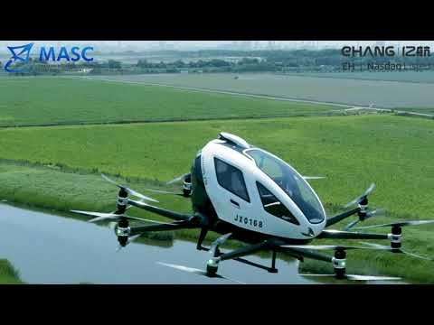

Slide 6
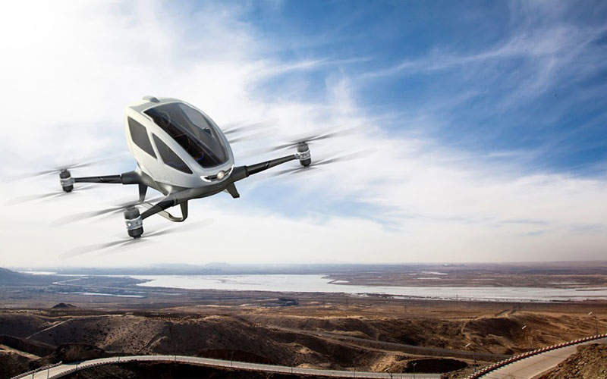
Ehang 184
Capacity: 1 passenger (or equivalent cargo)
Payload Capacity: Up to 100 kg (220 lbs)
Flight Time: Approximately 20-25 minutes, depending on conditions and payload
Cruising Speed: Around 60 km/h (37 mph)
Range: Up to 16 km (10 miles) on a single charge
Dimensions:
Length: Approximately 4.0 m (13.1 ft)
Height: About 1.5 m (4.9 ft)
Wingspan: Approximately 4.0 m (13.1 ft)
Motors: 4 electric motors for propulsion
Battery: Lithium-ion battery pack with rapid charging capabilities
Autonomy: Fully autonomous flight capabilities with GPS navigation and obstacle avoidance
Control System: Ground control station for monitoring and managing flights
Type: Brushless DC motors
Number of Motors: 4

Slide 7
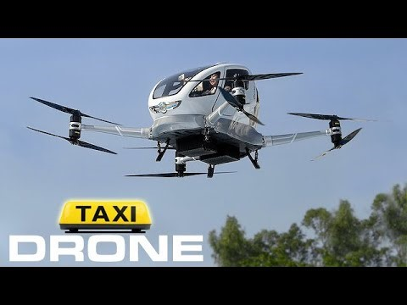

Slide 8
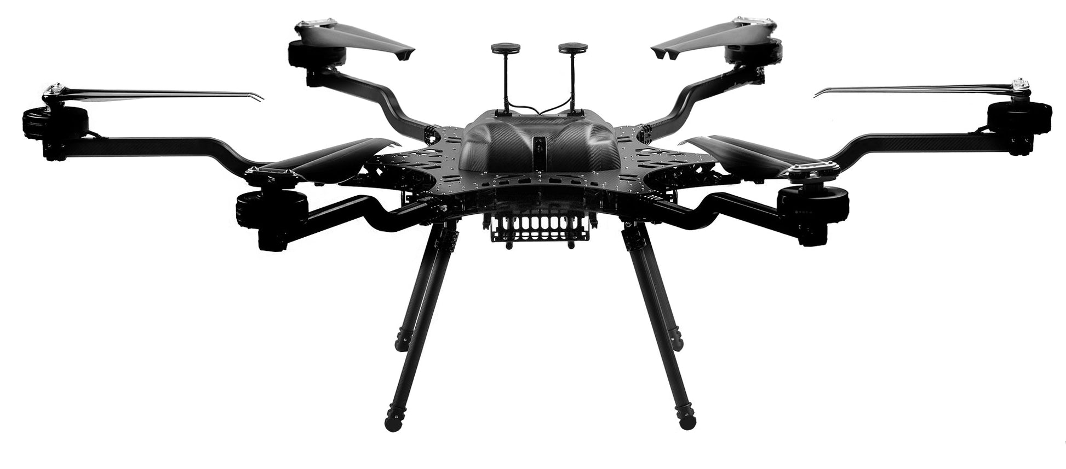
Harris Aerial Carrier H6 HL
Payload Capacity: Up to 50 kg (110 lbs)
Flight Time: Approximately 30-40 minutes, depending on the payload and flight conditions
Max Speed: Around 80 km/h (50 mph)
Range: Up to 30 km (18.6 miles) on a single charge
Dimensions: Typically around 1.5 m (4.9 ft) in diameter
Motors: Equipped with multiple electric motors for enhanced stability and lift
Battery: High-capacity lithium-polymer (LiPo) batteries with rapid charging capabilities
Control System: Autonomous and manual flight modes with advanced navigation features
Applications: Suitable for logistics, agriculture, surveillance, and emergency response
Type: Brushless DC motors
Number of Motors: Usually configured with six motors for redundancy and improved stability

Slide 9
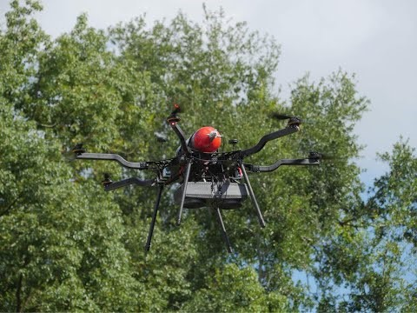

Slide 10
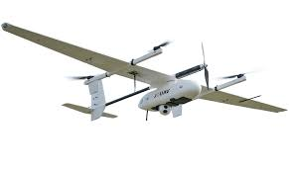
CW 15
Payload Capacity: Up to 15 kg (33 lbs)
Flight Time: Approximately 30-40 minutes, depending on the payload and environmental conditions
Max Speed: Around 60 km/h (37 mph)
Range: Up to 25 km (15.5 miles) on a single charge
Dimensions:
Diagonal Size: Approximately 1.5 m (4.9 ft)
Height: About 0.5 m (1.6 ft)
Motors: Typically equipped with multiple high-efficiency brushless motors
Battery: High-capacity lithium-polymer (LiPo) batteries, with rapid charging options
Control System: Autonomous flight capabilities with GPS navigation and obstacle avoidance
Type: Brushless DC motors
Number of Motors: Usually configured with four or more motors, depending on the model

Slide 11
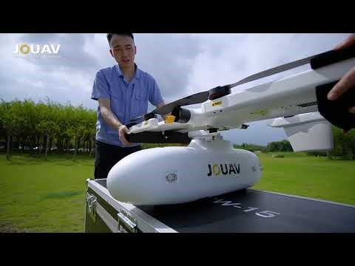

Slide 12
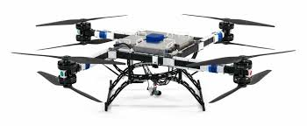
Flying Basket FB3 heavy-lift multirotor drone
Payload Capacity: Up to 120 kg (265 lbs)
Flight Time: Approximately 25-40 minutes, depending on payload and flight conditions
Max Speed: Around 70 km/h (43 mph)
Range: Typically up to 30 km (18.6 miles) on a single charge
Dimensions:
Diameter: Approximately 2.8 m (9.2 ft)
Motors: Equipped with multiple high-efficiency brushless motors (usually eight)
Battery: High-capacity lithium-polymer (LiPo) batteries with quick-recharge capabilities
Control System: Fully autonomous flight with GPS navigation, obstacle avoidance, and ground control station support
Applications: Ideal for logistics, agriculture, construction, and emergency response
Type: Brushless DC motors
Number of Motors: Typically configured with eight motors to provide stability and redundancy

Slide 13


